Slide 1

NEXT JS
React is relatively unopinionated about how you build and structure your applications.
There are multiple ways to build applications with React.
Next.js provides a framework to structure your application.
And optimizations that help make both the development process and final application faster.

Slide 2
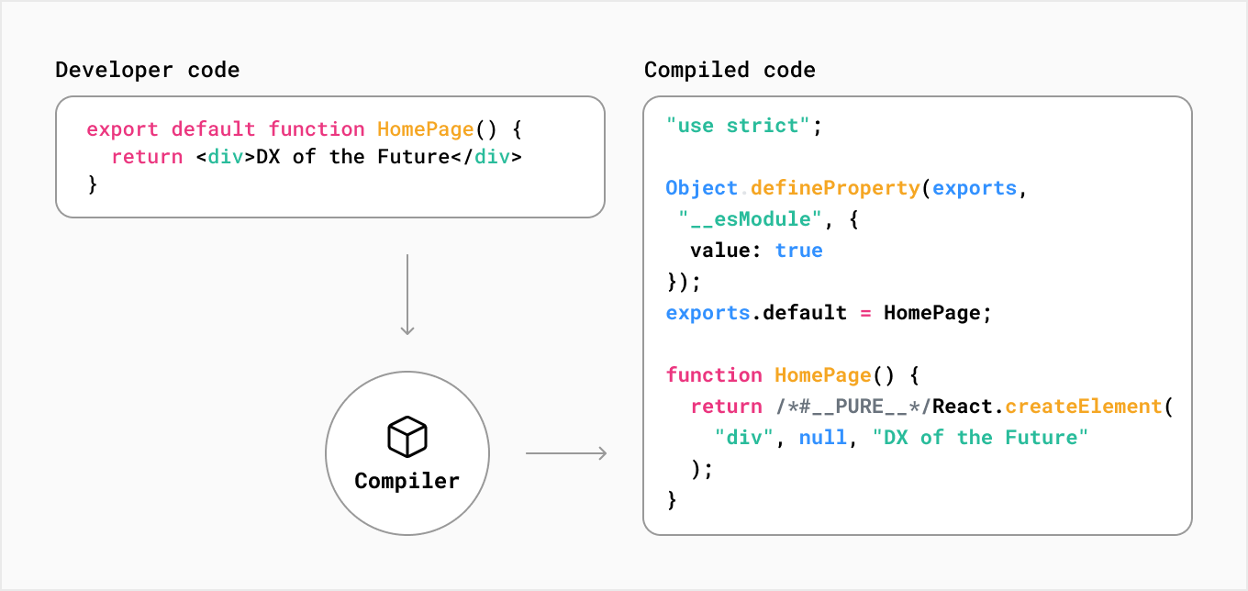
Developer Code & Compiled Code

Slide 3
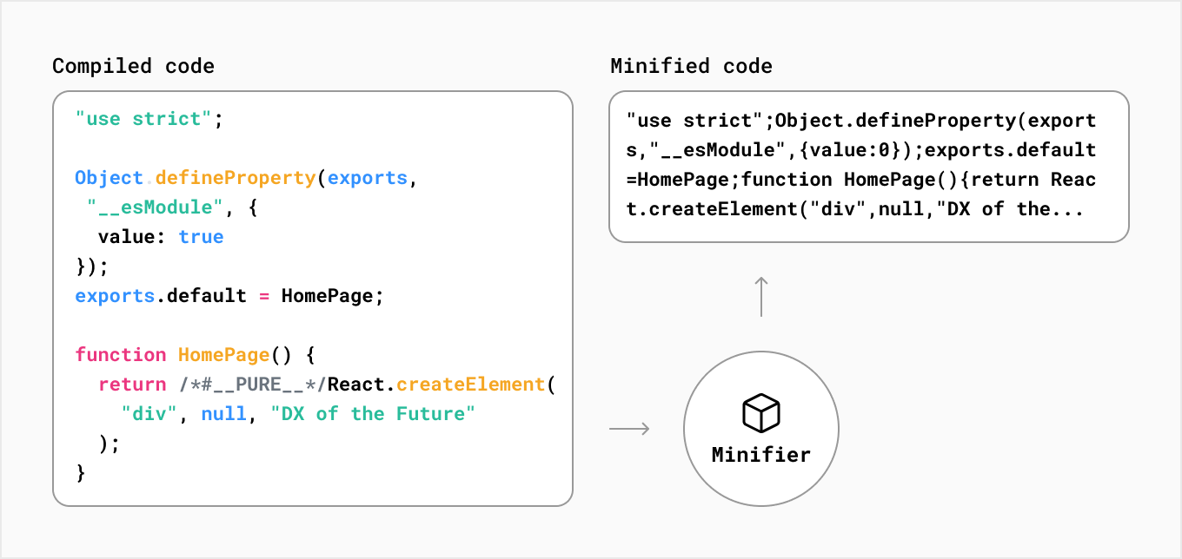
Compiled Code & Minified Code

Slide 4
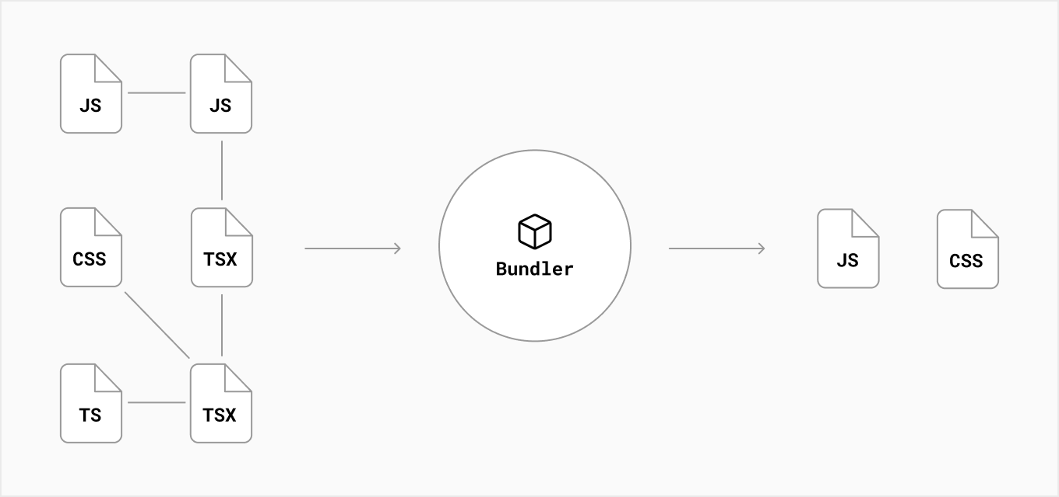
Bundler Concepts

Slide 5
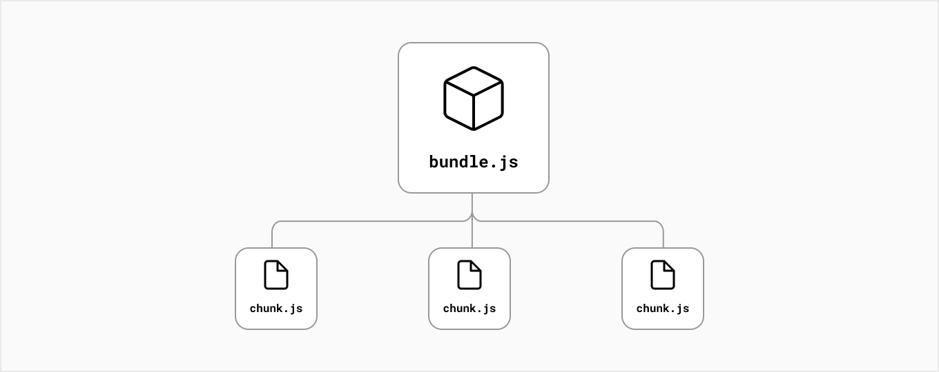
Bundle Spliting

Slide 6
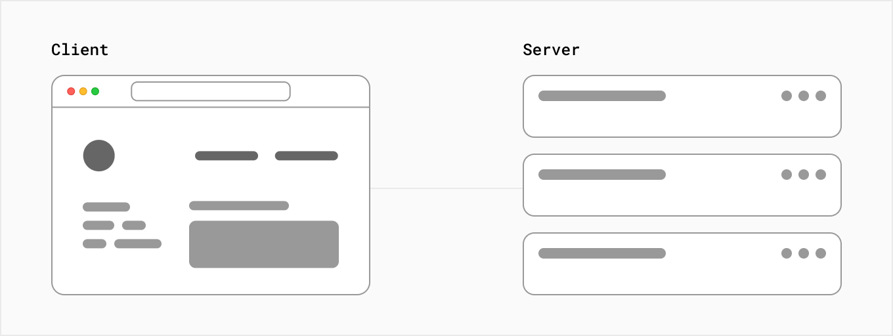
Client-Server Concepts

Slide 7
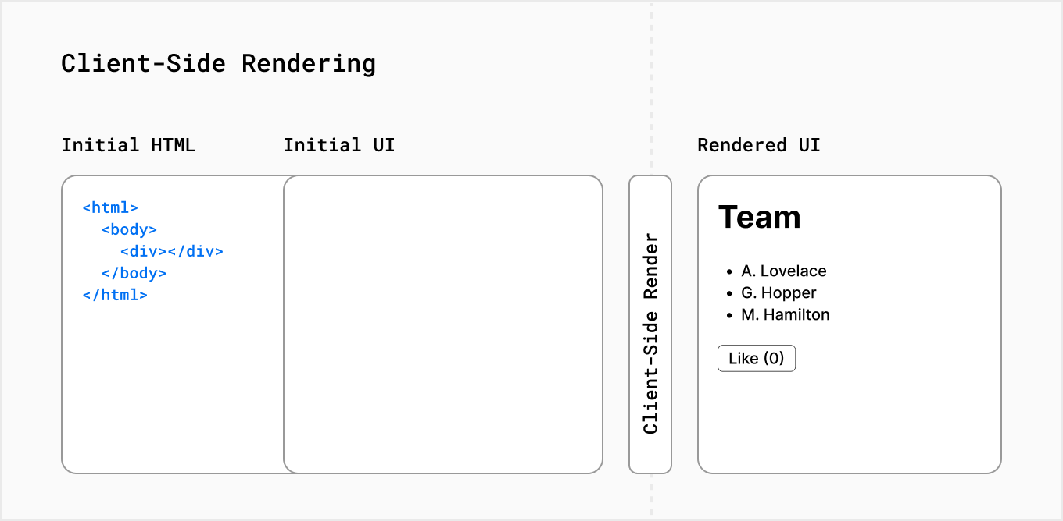
Client Side Rendering

Slide 8
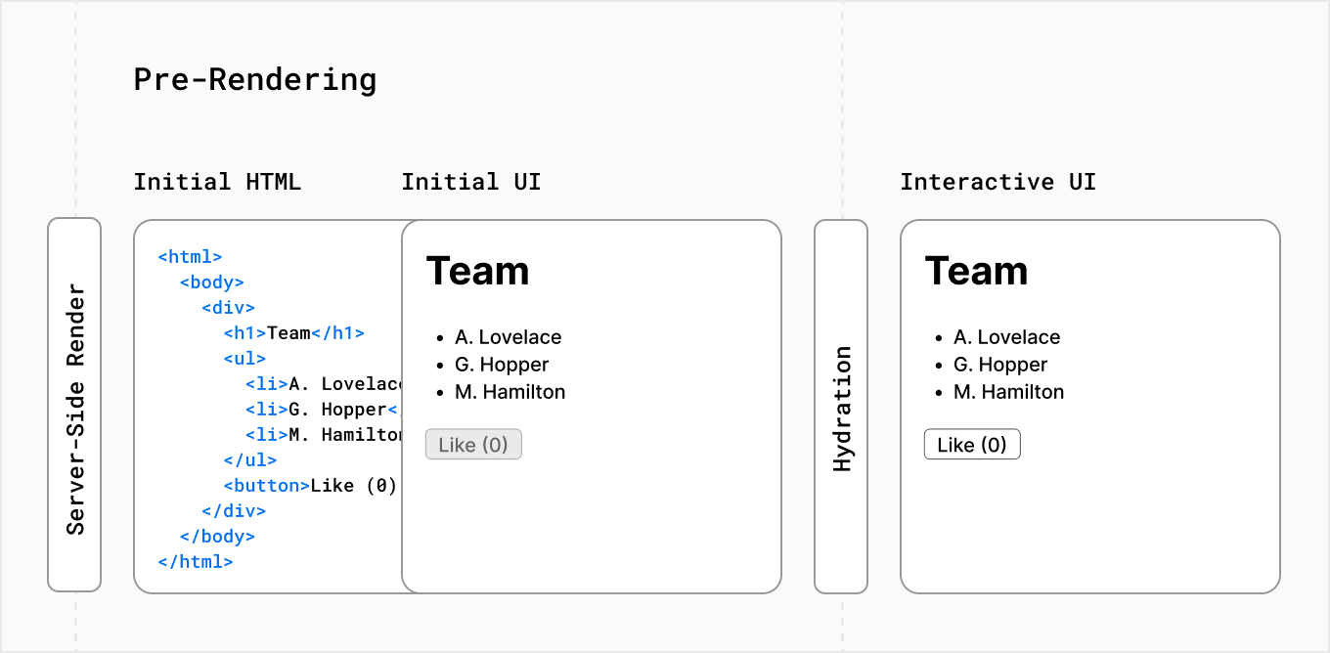
Server Side Rendering

Slide 9



Create & Run New Project

Slide 10
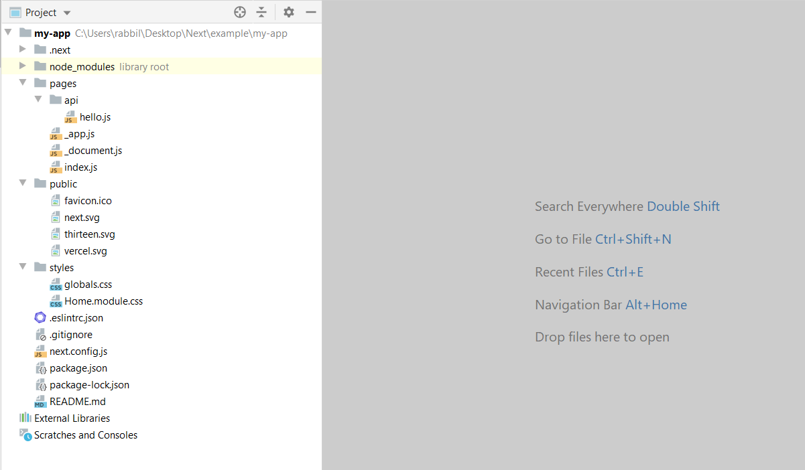
File Folder Structure

Slide 11
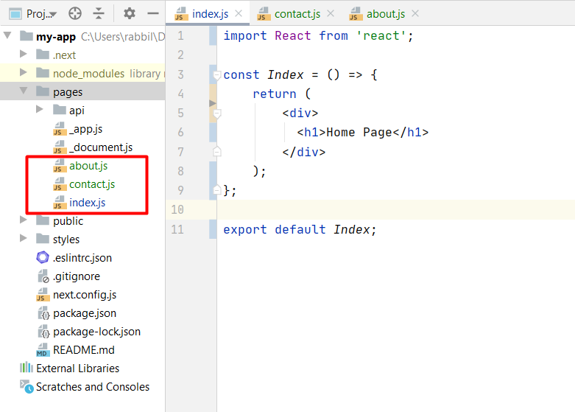
Page Concepts

Slide 12
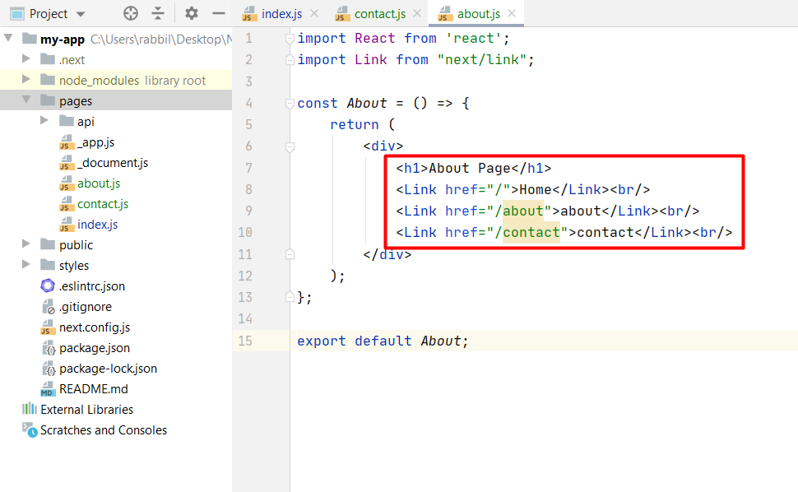
Link Component
When linking between pages on websites, you use the <a> HTML tag.
In Next.js, you can use the Link Component next/link to link between pages in your application.
Allows you to do client-side navigation and accepts props that give you better control over.

Slide 13
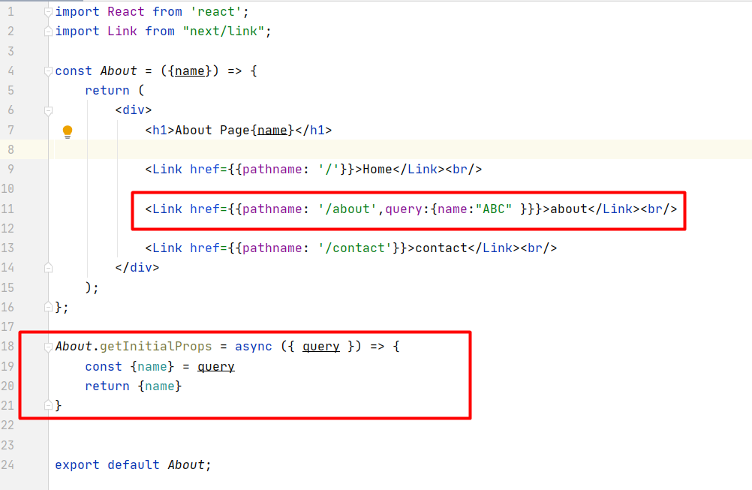
Link With Query

Slide 14
getInitialProps
getInitialProps enables server-side rendering in a page
Allows you to do initial data population
Sending the page with the data already populated from the server.
This is especially useful for SEO

Slide 15
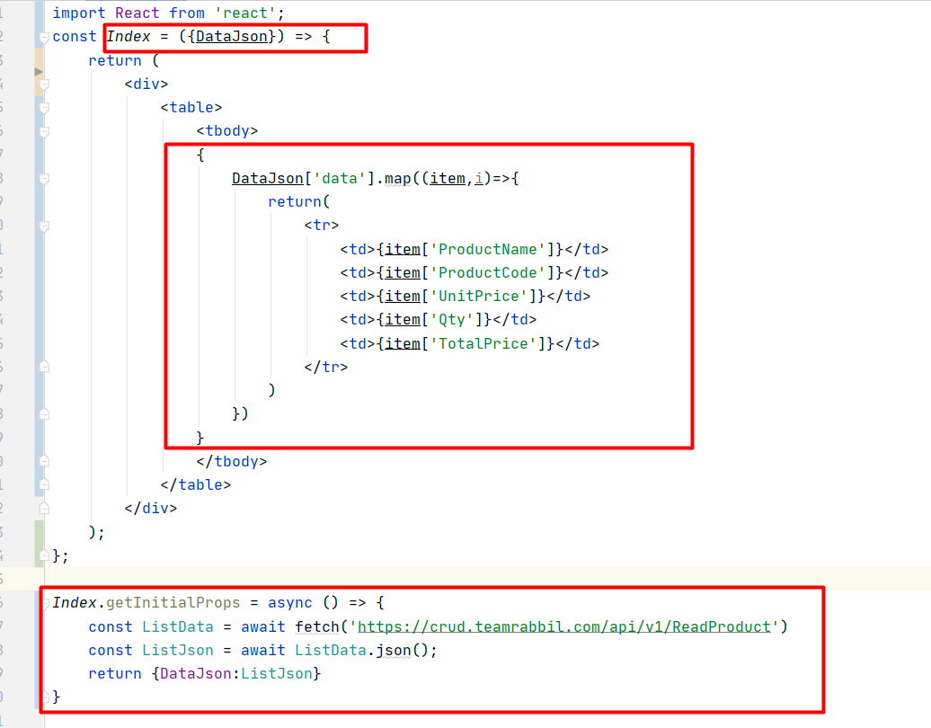
getInitialProps

Slide 16
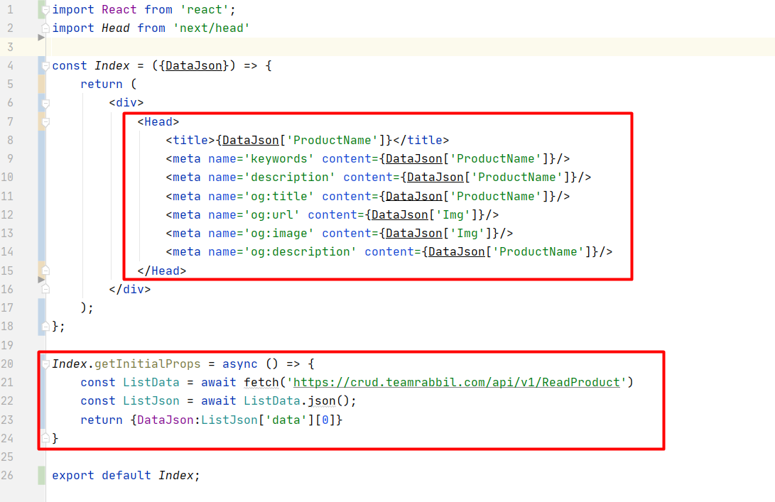
getInitialProps SEO

Slide 17
getInitialProps SEO

Slide 18
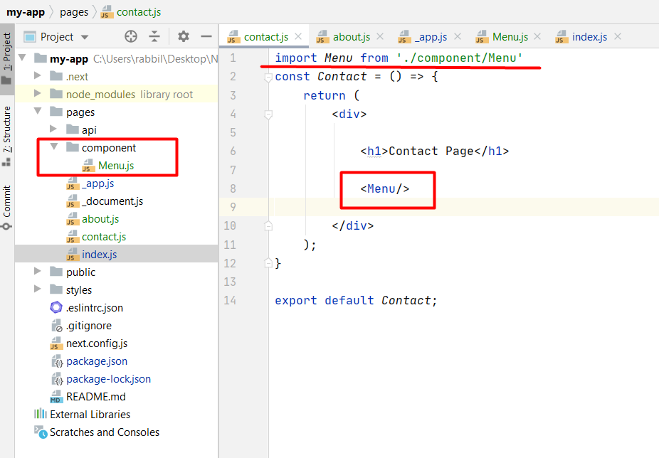
Working with Component

Slide 19
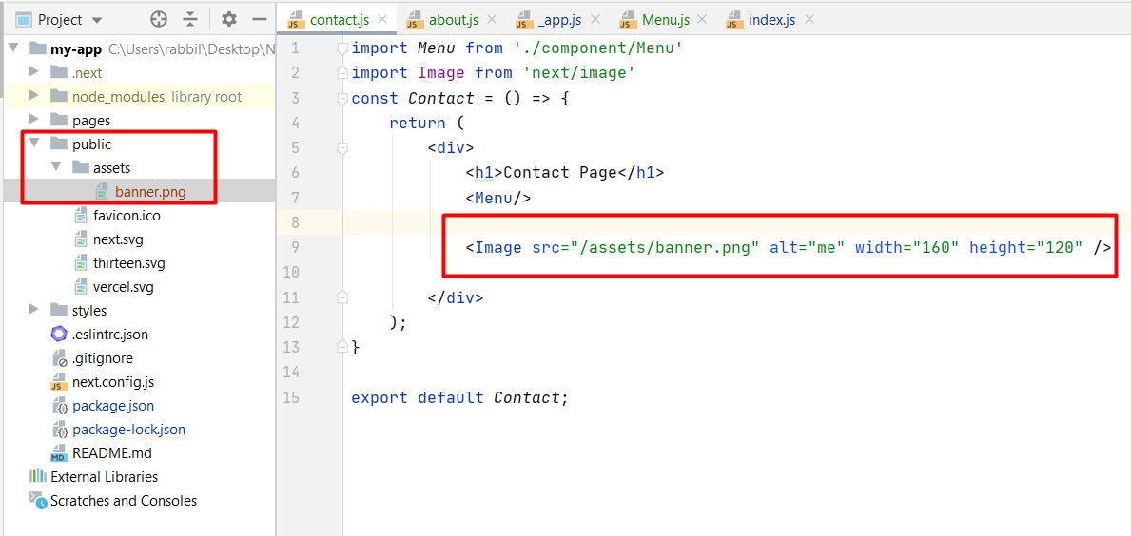
Static files

Slide 20
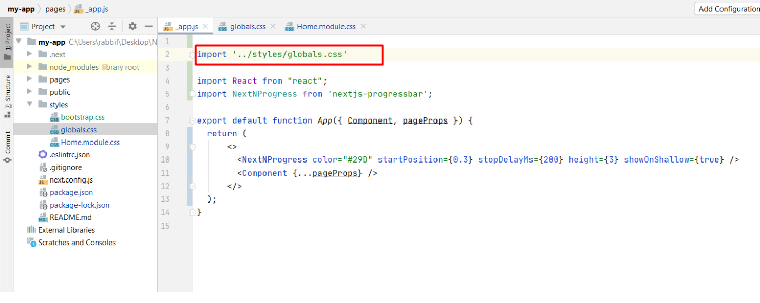
Global Style

Slide 21
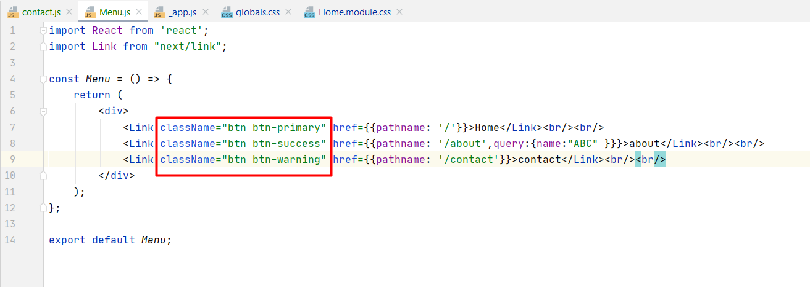
Global Style

Slide 22
X

Slide 23
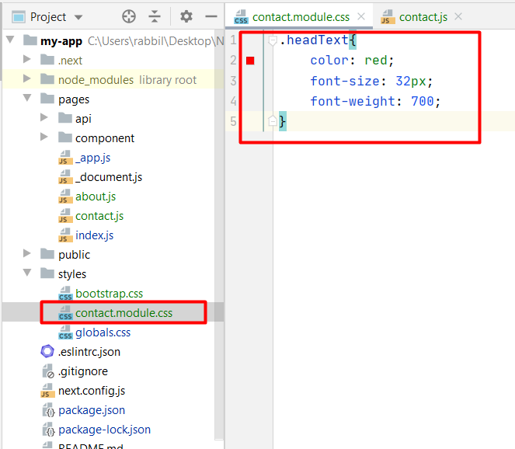
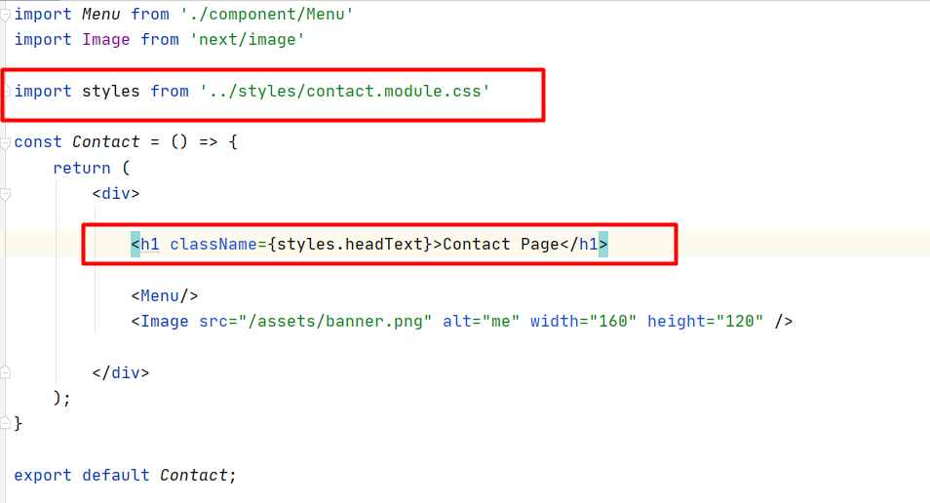
Component-Level CSS

Slide 24
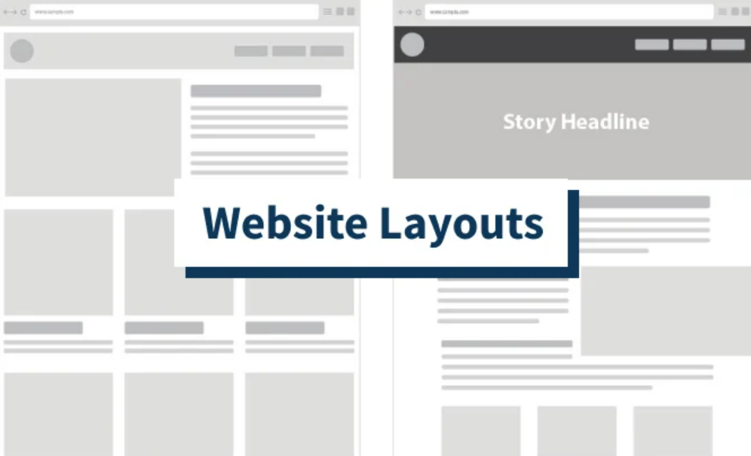
Layouts

Slide 25
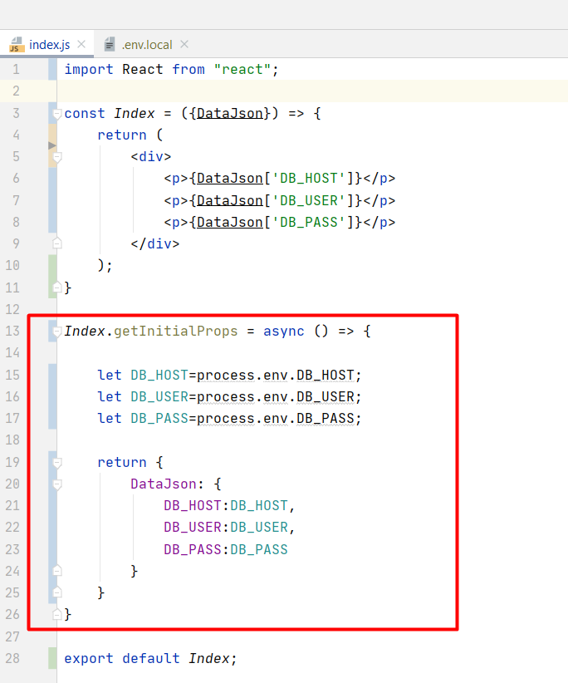
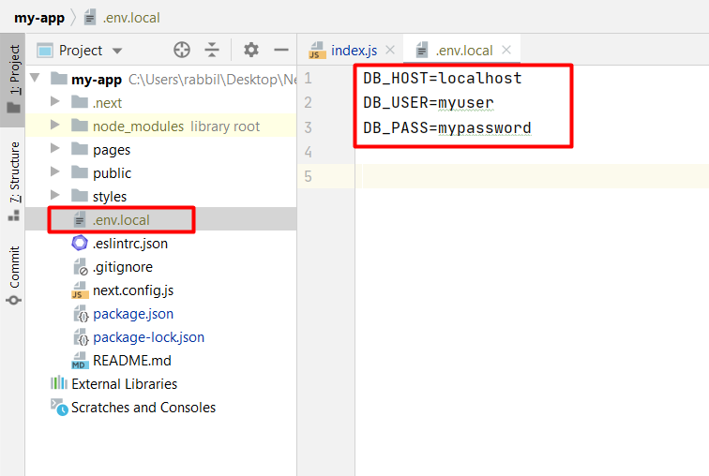
Environment Variables

Slide 26
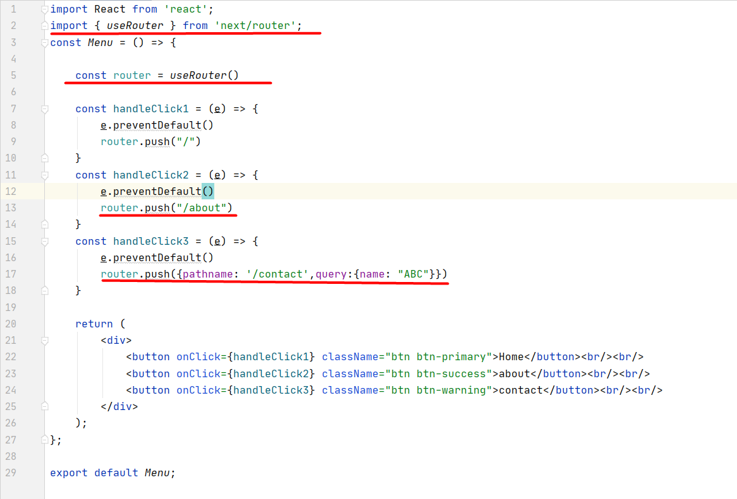
Next router

Slide 27
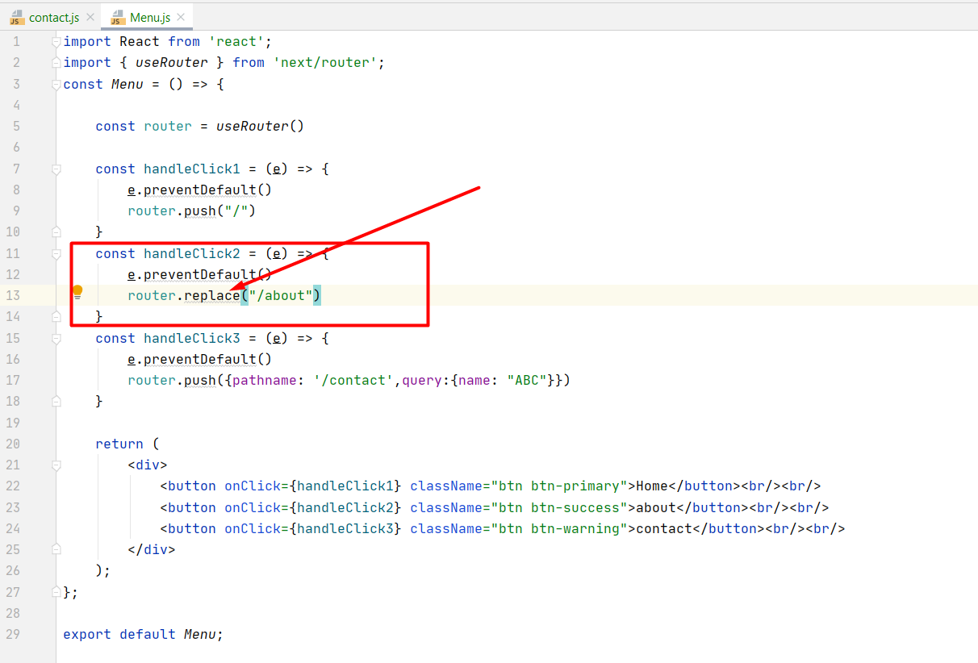
Next router

Slide 28
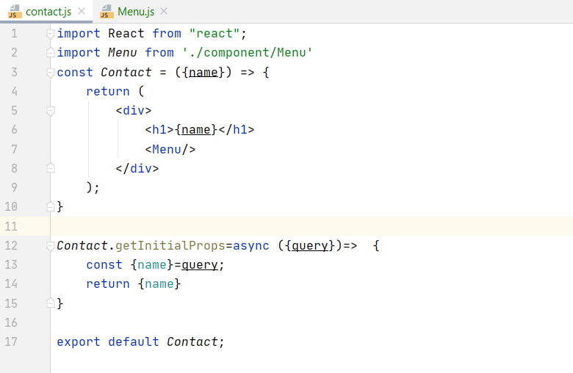
Next router

Slide 29
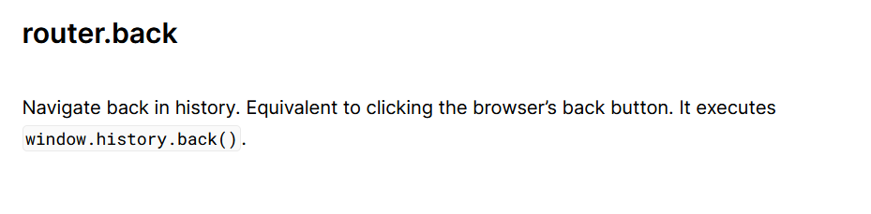
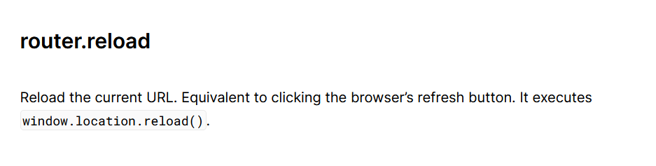
Next router

Slide 30
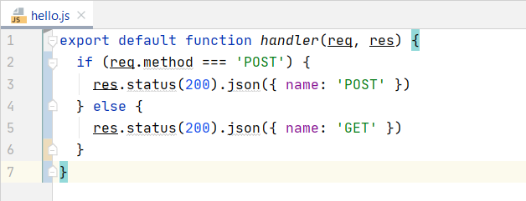
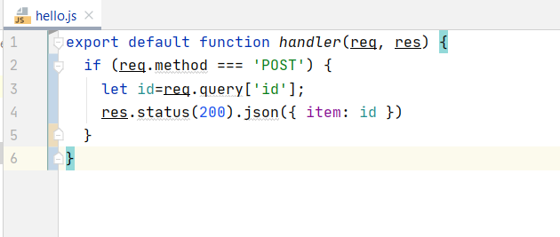
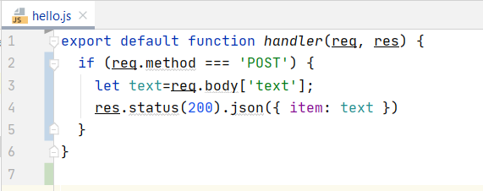
API Router

